Slide 1
Tizen Distro Introduction
Lin Yang
Intel Open Source Technology Centre

Slide 2
Objective
Building Tizen images with the building Tools of the Yocto Project. Currently, Tizen is built using the OBS and the Yocto project build system is an alternative.
Source:
https://review.tizen.org/gerrit/#/admin/projects/scm/bb/tizen-distro
https://review.tizen.org/gerrit/#/admin/projects/scm/bb/meta-tizen
Bug report: https://bugs.tizen.org/jira/browse/BTY

Slide 3
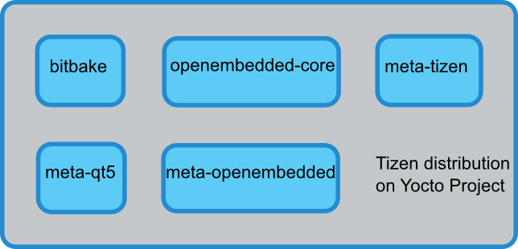
Tizen Distro
Tizen-Distro is an effort to create and maintain a self-contained distribution repository of Tizen, which is similar to Poky of the Yocto project - based on a similar project structure and using BitBake as the build tool.
Notes:
What is Tizen-distro:
Tizen-distro is a reference stack base on Yocto Project.
Tizen-distro is "self contained" in the sense that it basically contains all needed tools and recipes to bootstrap and build itself on any host system providing a minimal tool set.
Tizen-distro uses combo-layer, which allows it to be presented as one combined Git repository.
Tizen-distro would not depend on Poky, but, be based on OE-Core (like Poky).
Tizen-distro is maintained in a similar way as Poky.
Release:
rev_0.9
rev_ivi_2015_02_04

Slide 4
Tizen Distro Release
Tizen IVI: rev_ivi_2015_02_04
corresponds to Tizen IVI 3.0.
Tizen Common: rev_0.9
Notes:
What is Tizen-distro:
Tizen-distro is a reference stack base on Yocto Project.
Tizen-distro is "self contained" in the sense that it basically contains all needed tools and recipes to bootstrap and build itself on any host system providing a minimal tool set.
Tizen-distro uses combo-layer, which allows it to be presented as one combined Git repository.
Tizen-distro would not depend on Poky, but, be based on OE-Core (like Poky).
Tizen-distro is maintained in a similar way as Poky.
Release:
rev_0.9
rev_ivi_2015_02_04

Slide 5
Meta-tizen
Meta container of the project Tizen On Yocto Project
meta-tizen-common-base
meta-tizen-common-demo
meta-tizen-common-shared
meta-tizen-ivi
meta-tizen-common-devtools
meta-tizen-adaptation-oe-core
meta-tizen-adaptation-meta-oe
Notes:
Recipes meta-tizen-common-base
meta recipes containing Tizen core package This meta contain the Tizen distro configuration
Recipes meta-tizen-common-demo
meta recipes to create Tizen Common Image
Recipes meta-tizen-common-shared
meta recipes containing optional package shared between Tizen Project profile
crosswalk
tizen-extensions-crosswalk
ofono
murphy
efl
Qt5 BTY-66
...
Recipes meta-tizen-ivi
meta recipes related to Tizen IVI
Recipes meta-tizen-common-devtools
meta recipes with tizen devtools:
testkit-lite
testkit-stub
common-crosswalk-suite
common-graphics-suite
common-multimedia-suite
common-sanity-suite
common-suite-launcher
ivi-sanity-suite
python-requests
...
Recipes meta-tizen-adaptation-oe-core
Tizen specific extension to oe-core recipes.
Recipes meta-tizen-adaptation-meta-oe
Tizen specific extension to meta-openembedded recipes.

Slide 6
Build(1)
For Tizen Common
cd tizen-distro
git checkout tizen
build_directory_name=build-common
source ./tizen-common-init-build-env $build_directory_name
For Tizen IVI
cd tizen-distro
git checkout tizen-ivi
build_directory_name=build-modello
source ./tizen-ivi-init-build-env $build_directory_name

Slide 7
Build(2)
conf/local.conf
64 bits build: MACHINE ??= "genericx86-64"
32 bits build: MACHINE ??= "genericx86“
Build an image
bitbake tizen-ivi-Modello-image

Slide 8
Tizen Distro Introduction
The following is a proposal for combining the current Tizen workflow and repository layout with a new BitBake-based development model:
It does not try to change existing Tizen practices, but, add a BitBake workflow parallel to that.
Mapping to the current Tizen development model:
The combined tizen-distro repository reflects whatever has been currently integrated into Tizen image.

Slide 9
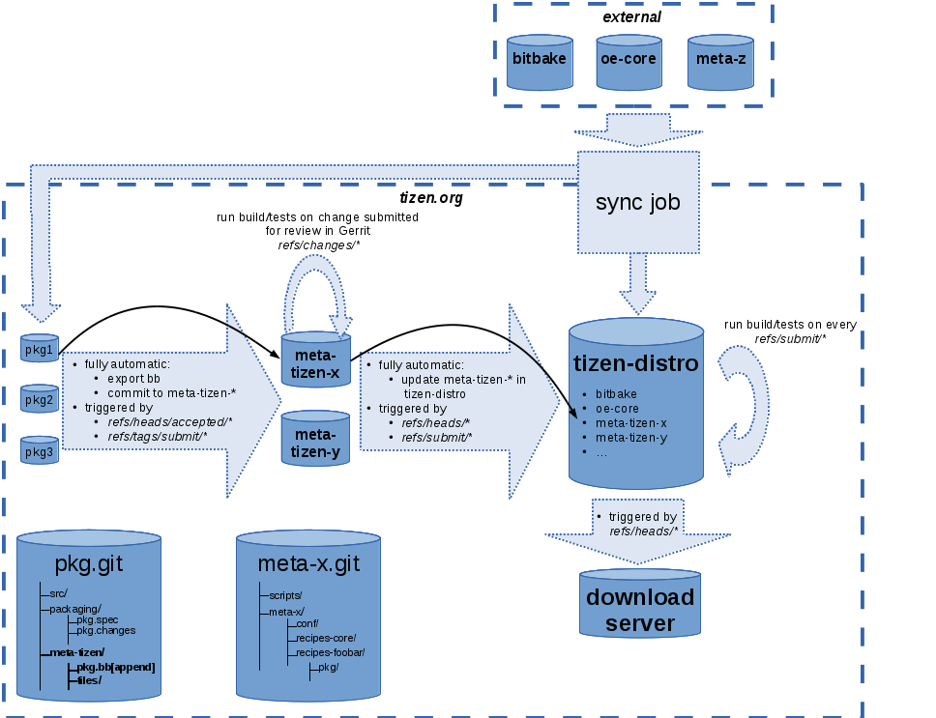
Tizen Distro Workflow
Notes:
The following is a proposal for combining the current Tizen workflow and repository layout with a new BitBake-based development model:
It does not try to change existing Tizen practices, but, add a BitBake workflow parallel to that.
Tizen development would still be done on per-package Git repositories in Tizen gerrit, changes would be "submitted" with Git tags etc.
Mapping to the current Tizen development model:
The combined tizen-distro repository reflects whatever has been currently integrated into Tizen image.

Slide 10
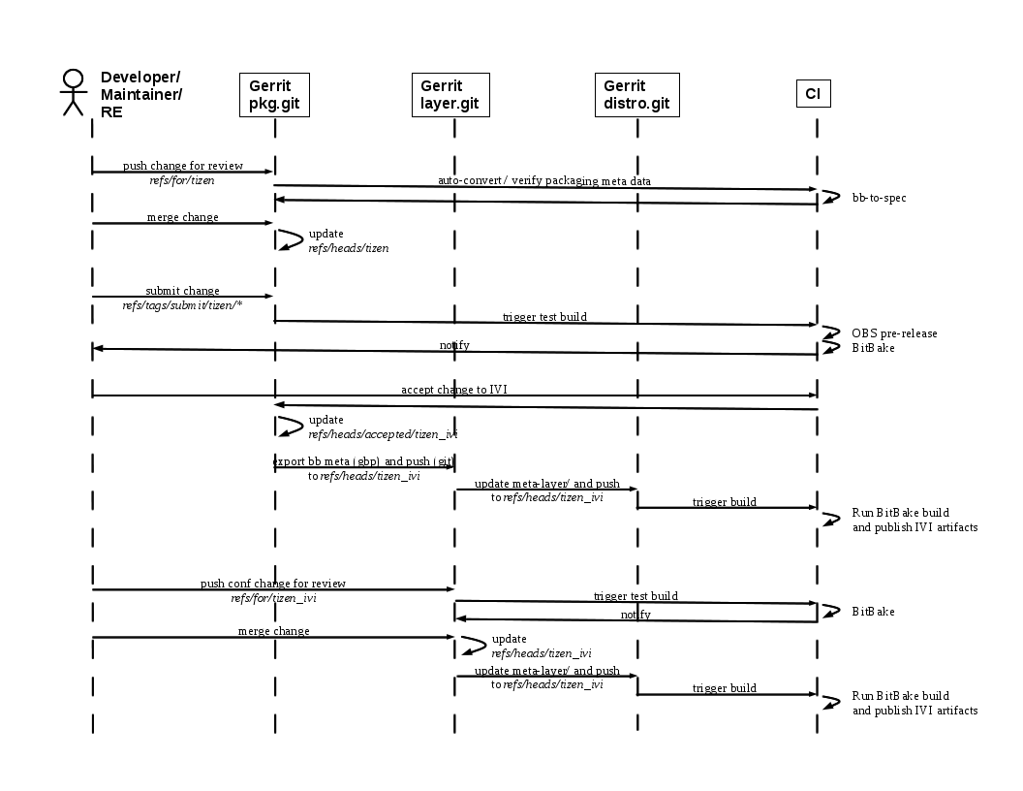
Workflow Sequence

Slide 11
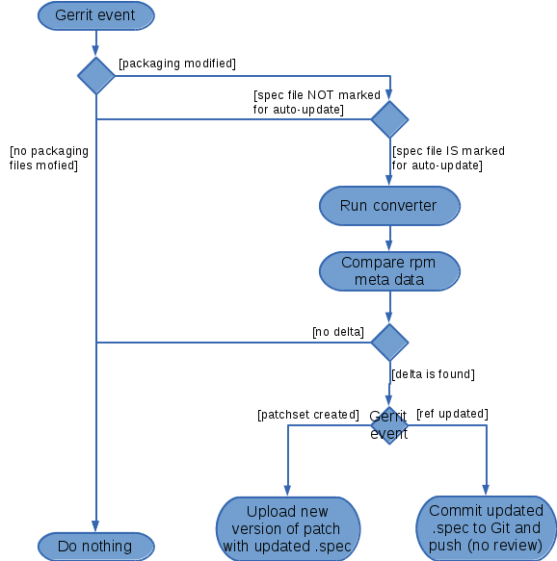
Spec autoupdate
Skip if no change in packaging metadata.
Skip if rpm metadata has NOT been marked to be automatically maintained (e.g. by a special header section in the spec file)
Otherwise, run bb-to-spec conversion and compare to existing rpm metadata. If delta is found:
If a patcset was created/updated, upload a new version of the patcset with the auto-updated rpm packaging files.
If a ref was updated (branch head updated via Gerrit merge or direct push) -> make a new commit with the auto-generated rpm metadata and push to Git automatically without review
Notes:
Skip if no change in packaging metadata. This way, we do not force-introduce packaging changes by convertor when only source code is modified.
Skip if rpm metadata has NOT been marked to be automatically maintained (e.g. by a special header section in the spec file)
Otherwise, run bb-to-spec conversion and compare to existing rpm metadata. If delta is found:
If a patcset was created/updated, upload a new version of the patcset with the auto-updated rpm packaging files.
If a ref was updated (branch head updated via Gerrit merge or direct push) -> make a new commit with the auto-generated rpm metadata and push to Git automatically without review

